Slide 1
ADULT, COMMUNITY AND FURTHER EDUCATION BOARD
Expression of Interest Process
For 2024 ACFE Board Training Delivery
August 2023

Slide 2
Acknowledgement of Country
We acknowledge the Traditional Owners of the land on which we are meeting. We pay our respects to their Elders, past, present and emerging and the Aboriginal Elders of other communities who may be here today.
You can use the interactive map in this link to locate and acknowledge the Formally Recognised Traditional Owners of the land you are on:
Welcome Map (achris.vic.gov.au)

Slide 3
INCLUDED IN TODAY’S SESSION
1
2
3
4
5
Overview
Roles and Priorities
Purpose of ACFE Training Delivery
How to apply – EOI process and timelines
Program delivery streams
General Pre-accredited
Additional Digital and Employability (with a digital component)
Places
Reporting and Payments
Resources and Supports
Next Steps

Slide 4
OVERVIEW

Slide 5
STRATEGIC CONTEXT
The Learn Local sector plays a vital role in changing the lives of Victorians each year by supporting learners to achieve their goals.
The Learn Local modules (courses) that you all deliver every day, make a real difference in people’s lives. We know how hard you and your teams work to ensure each and every learner has an opportunity to achieve their goals.
There is a wealth of great examples on the Learn Local social media channels:
Learn Local website (for learners): www.learnlocal.org.au
X (Twitter): www.twitter.com/learnlocal
YouTube: www.youtube.com/learnlocal
The delivery of ACFE Board-funded training programs is a core component of this work. This EOI begins the planning and allocation process for ACFE training delivery in 2024.

Slide 6
INTRODUCTION OF PQF+ THROUGH THE STRONGER BY DESIGN MODEL
As part of its ongoing commitment to continuous improvement in meeting Victorian’s core skills needs for study, work and life, the ACFE Board is implementing a new pre-accredited model through the Stronger by Design initiative.
Stronger by Design does not signal a major change to pre-accredited provision. Instead, it aims to build on the recognised strengths of the existing pre-accredited model. This includes updating the current Pre-accredited Quality Framework (PQF) introduced in 2013, to PQF+.
Some Learn Local providers have been doing pilot testing of the model through 2022-23 and piloting will continue through 2024.
Learn Local providers will be fully supported to transition to PQF+ and the Stronger by Design model to build their skills and capabilities to adopt the new tools and processes.

Slide 7
CENTRAL RESOURCES
The ACFE Board is supporting the development of centrally developed resources in both General Pre-accredited and Additional Digital and Employability (with a digital component) program streams, to support Learn Local provider delivery.
These resources are available on the Learn Local Secure Portal and the Learn Local website: See www.learnlocal.org.au/resources password ‘local’).
In addition to the central resources currently available, all modules that have been mapped to PQF+ will be made available for use by Learn Locals providers in 2024. These will be clearly indicated as PQF+ through Stronger by Design.
These can all be accessed and adapted to meet local community needs, even outside of the Stronger by Design model. Learn Local providers should review and use or adapt these centrally developed resources as a first consideration when planning their EOI responses.

Slide 8
ACFE TRAINING DELIVERY ROLES AND PRIORITIES

Slide 9
ACFE BOARD AND REGIONAL COUNCIL ROLES
ACFE BOARD
REGIONAL COUNCIL
The role of the ACFE Board is to plan and promote adult learning, allocate resources, develop policies, and advise the Minister for Training and Skills and Higher Education on matters related to adult education in Victoria.
Through the Board, the Victorian Government provides funding to Learn Local providers, AMES Australia and the CAE, to deliver education and training programs to a broad range of Victorians over compulsory school-leaving age, with a special focus on people who have had limited prior access to education.
Using their different expertise and local knowledge about adult education, Regional Councils advise the ACFE Board on the needs of adult education across their region and contribute to statewide planning and policy development.

Slide 10
2024 ACFE TRAINING DELIVERY PRIORITIES
ACFE Board Strategy 2020-25
Pre-accredited programs must reflect the Board’s strategic priorities outlined in the ACFE Board Strategy 2020-25.
The Strategy is a primary means to implement the Ministerial Statement on the Future of Adult Community Education in Victoria 2020-25.
The ACFE Board has identified people who have experienced educational disadvantage as a priority in the design and delivery of pre-accredited programs. All pre-accredited modules should have a clear focus on Language, Literacy, Numeracy, Employability or Digital (LLNED) skills.
Victoria

Slide 11
2024 ACFE TRAINING DELIVERY PRIORITIES
Additional Digital and Employability Places
The Victorian Budget 2023-24 provides funding over two years, to address the skills knowledge base required to ensure thousands of pre-accredited learners have the digital literacy and employability skills they need to improve their employment prospects.
Training delivery hours are available in 2024 as part of the first year of the Additional Digital and Employability Pre-accredited Places Budget initiative. This will include delivery through the Digital Literacy Essentials and Employability with a Digital Component training delivery program categories.
Victoria

Slide 12
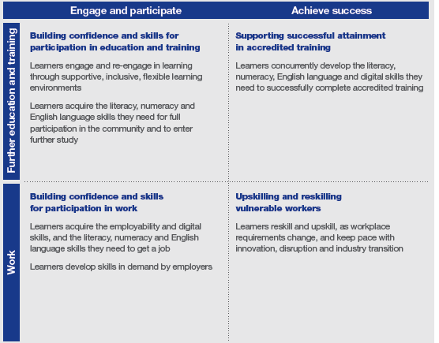
KEY AREAS FOR ACFE TRAINING
Contracted providers are expected to deliver pre-accredited courses aligned to one or more of the four areas of learner need outlined in the ACFE Board Strategy 2020-25 (p8):

Slide 13
PURPOSE OF ACFE TRAINING DELIVERY

Slide 14
ACFE TRAINING DELIVERY
The primary purpose of pre-accredited education and training is to provide opportunities for adult learners in Victoria to gain the educational capacity and core skills they need for study, work and life. Core skills are defined in the Ministerial Statement on the Future of Adult Community Education in Victoria 2020-25 as language, literacy, numeracy, employability and digital skills (LLNED).
Pre-accredited education and training addresses the particular needs of adults who have experienced barriers to education in the past.
Pre-accredited training programs focus on creating pathways for learners to further education and training or a pathway to employment.
Programs are designed to be flexible, meet learners’ needs and support them to return to study, improve their literacy and numeracy skills, their qualification pathways and broaden their employment options.

Slide 15
THE PRE-ACCREDITED QUALITY FRAMEWORK
All modules on your Delivery Plan must meet the requirements of the Pre-accredited Quality Framework (PQF).
The PQF, launched in 2013, is a system of interrelated processes that ensure quality and continuous improvement in the cycle of planning, developing, implementing and reviewing pre- accredited modules.
The PQF supports teachers and managers to plan, develop, teach and review pre-accredited modules.
Key Components of the PQF
A-FRAME
Pre-accredited module planning resource
EVALUATION
Includes the processes and documentation for moderation and verification

Slide 16
THE PRE-ACCREDITED QUALITY FRAMEWORK
Centrally developed pre-accredited modules
Learn Local providers should review and use or adapt the centrally developed resources on the Learn Local website or Learn Local Secure Portal as a first consideration when planning their EOI responses.
This will minimise duplication of resources and increase utilisation of quality assured A-frames where available. Regional teams will review this during the assessment of Delivery Plans.
Learn Local developed pre-accredited modules
Learn Local providers seeking to develop or adapt a pre-accredited module must ensure they are designed and delivered in accordance with the PQF. These include:
new locally developed modules
existing locally developed modules
centrally developed modules that are modified (more than 30% change is a new locally developed module)

Slide 17
WHAT IS PQF+ AND STRONGER BY DESIGN?
PQF+ and Stronger by Design will provide Learn Local providers with an updated quality framework to guide and inform the development and delivery of pre-accredited training into the future.
It will deliver a new range of curated tools, guides, strategies and templates along with step by step guidance, tailored to the needs of a wide range of learners and Learn local organisations; from small neighbourhood houses to large organisations that also deliver accredited training.
Learn Local teachers, coordinators and administrators will be supported through subsidised access to newly developed professional development modules on key aspects of the new model, such as strategies for identifying learner need and recognising learner gain.

Slide 18
WHAT DOES PQF+ AND STRONGER BY DESIGN MEAN FOR ME IN 2024?
For Learn Local providers that DID NOT participate in the Stronger by Design pilots
Minimal change in the 2024 EOI process.
You can use centrally developed modules in your Delivery Plans, including those mapped to PQF+. This is to allow you time to transition and become accustomed to elements of PQF+.
Until you have completed the professional development, you are not expected to implement all aspects of PQF+ through the Stronger by Design model.
Once you have completed the professional development, it is expected that you will implement all elements of the Stronger by Design model.
Contact your regional office to discuss the best timeframe to do the professional development.
For Learn Locals that DID participate in the Stronger by Design pilots:
If you participated in the pilot, as leaders you are expected to nominate PQF+ modules in your Delivery Plans for 2024.
Please ensure that these PQF+ modules are accurately reflected in your Delivery Plans.

Slide 19
ACFE TRAINING DELIVERY EXPRESSION OF INTEREST PROCESS AND TIMELINE

Slide 20
PROVIDER ELIGIBILITY
To be eligible to receive funding for government subsidised pre-accredited training, providers must have:
ACFE Board Registration
AMES Australia and CAE are covered under the Education and Training Reform Act 2006
SAMS2 Registration
An AVETMISS-compliant Student Management System
Trained Staff to use your SMS and SVTS
Current Business and Governance Status (BGS) or
Have a current Skills First contract to deliver government subsidised accredited training.
Delivery Plan and A-frames aligned with the ACFE Board Strategy 2020-25

Slide 21
LEARNER ELIGIBILITY
 |  | ELIGIBILE | NOT ELIGIBLE
ELIGIBLE LEARNERS | Australian Citizen, or Holder of an Australian permanent visa New Zealand citizen Asylum seekers holding valid visa that confers eligibility for Skills First training.
 | Holder of an Australian permanent visa
 | New Zealand citizen
 | AND:
 | Meets age requirement 17 and over and not enrolled at school Under 17 and not enrolled at school with exemption.
 | Under 17 and not enrolled at school with exemption
 | If documentation unavailable Where no documentation confirming citizenship and/or age can be produced, an authorised delegate of the training provider can grant eligibility on face value, via interview.
 |  | ELIGIBILE | NOT ELIGIBLE
INELIGIBLE LEARNERS | A prisoner held at a prison, within the meaning of the Corrections Act 1986. |  | ✗
 | Detained under the Mental Health Act 1986; or the Crimes (Mental Impairment and Unfitness to be Tried) Act 1997 or the Sentencing Act 1991 at the Thomas Embling Hospital. |  | ✗
 | Detained (other than on weekend detention) under the Children, Youth and Families Act 2005 or the Sentencing Act 1991 or who is held on remand in the Malmsbury Juvenile Justice Centre or Parkville Youth Residential Centre. |  | ✗
 | Non-citizenship/permanent residents and Asylum seekers not listed in the previous table. |  | ✗
 | Learn Local paid staff are regarded as Fee for Service enrolments |  | ✗

Slide 22
PROCUREMENT BY EXPRESSION OF INTEREST
The ACFE Board has allocated student contact hours for General Pre-accredited Training and Additional Digital and Employability (with a digital component) Places, across the 8 ACFE regional areas under a fixed annual budget. These hours are distributed through the Expression of Interest (EOI) process. The resource allocation model has been updated to reflect 2021 Census data and entails redistribution of some resources amongst regions. This may mean that allocations shift over time according to need backed by data. However, every attempt will be made to do this in a sensitive way.

Slide 23
PROCUREMENT BY EXPRESSION OF INTEREST
The 2024 EOI process is streamlined for 2024. There are two program streams available:
General Pre-accredited Training - funded from the ACFE Pre-accredited Training Budget.
Language
Literacy
Numeracy
Employability
Engagement (5-15 hours)
Additional Digital and Employability Places- funded from the Victorian Budget 2023-24.
Digital Literacy Essentials
Employability with a Digital Component

Slide 24
PROGRAM CATEGORY UPDATE
Learn Local providers will note that ‘Vocational’ has been discontinued as a specified program category for pre-accredited training. This brings ACFE program categories into alignment with the definition of ‘core skills’ contained in the Ministerial Statement on the Future of Adult Community Education in Victoria 2020-25 which include Language, Literacy, Numeracy, Employability and Digital skills.
Existing pre-accredited modules that Learn Local providers have been delivering under the ’Vocational’ program category will need to focus on and be categorised as at least one of Language, Literacy, Numeracy, Employability and Digital core skills, in order to be approved for contracting in 2024.
Please note that pre-accredited modules can still be contextualised to an occupation, industry or career pathway or outcome. The aim here is to ensure that pre-accredited training remains focussed on core rather than technical skills.

Slide 25
HOW TO APPLY FOR ACFE PROGRAM TRAINING DELIVERY FUNDING IN 2024 EOI OPENED 28 AUGUST AND CLOSES ON 15 SEPTEMBER 2023
1
Download and read the ACFE 2024 Training Delivery Guidelines
2
Download the ACFE 2024 Delivery Plan template
3
Complete the 2024 ACFE Delivery Plan by LGA and program stream. Please ensure you list your modules in order of priority
4
Prepare a full A-frame including Module Plans and Session Plans for new or existing locally developed pre-accredited modules. For centrally developed modules, use the existing A-frames
5
Submit your EOI Delivery Plan by COB 15 September 2023 via email to: training.participation@education.vic.gov.au
6
A-frames can be submitted with the Delivery Plan or separately by Tuesday, 30 November 2023. You do not need to submit A-frames for centrally developed modules

Slide 26
DELIVERY PLAN
The 2024 Delivery Plan Worksheet template is similar to the 2023 Delivery Plan template. It enables Learn Local providers to manually input and amend module information, but still includes some automated features.
The 2024 Delivery Plan template will be in the form of an Excel workbook with four visible tabs:
Tab 1 – Guide to completing your Delivery Plan Worksheet
Tab 2 – 2024 Delivery Plan Summary (Summary)
Tab 3 – 2024 General Pre-accredited Delivery Plan Worksheet
Tab 4 – 2024 Additional Digital and Employability Delivery Plan Worksheet.

Slide 27
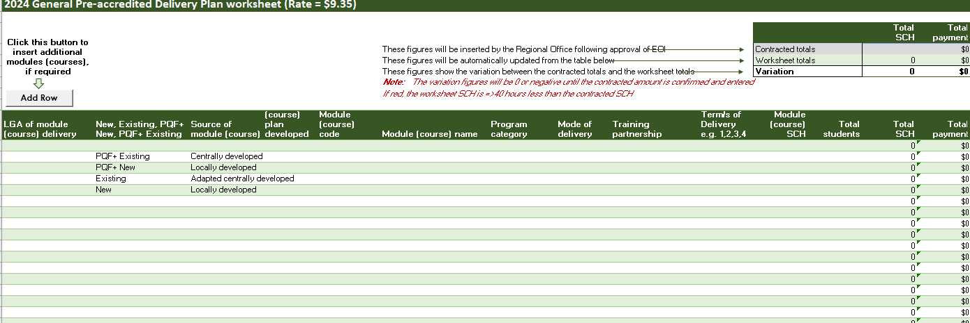
DELIVERY PLAN TAB 3 – GENERAL PRE-ACCREDITED WORKSHEET

Slide 28
DELIVERY PLAN TAB 4 – ADDITIONAL DIGITAL AND EMPLOYABILITY PLACES WORKSHEET

Slide 29
DELIVERY PLAN TAB 2 - SUMMARY

Slide 30
HOW TO SUBMIT AN EXPRESSION OF INTEREST
To submit your EOI, complete and submit a draft Delivery Plan EOI which clearly indicates the total number of SCH in each training delivery program stream (General Pre-accredited and Additional Digital and Employability Places) by LGA, that you are requesting.
Complete tab 3 (General Pre-accredited Delivery Plan Worksheet) and/or tab 4 (Additional Digital and Employability Places Delivery Plan Worksheet) as appropriate, with your proposed modules. These figures will be automatically generated on the Summary tab (2) as you complete the two Worksheets. Please complete your organisation details in the Summary tab.
While final details of individual modules are not required until a later date, we do need a final request of SCH by program stream and LGA by 15 September 2023. Submit by email to training.participation@education.vic.gov.au
You will then be able to continue to modify how these hours are allocated by individual module on your Delivery Plan Worksheet(s).
Your proposed Delivery Plan will be considered for its alignment with the ACFE Board Strategy 2020-25, the intent, content and quality of proposed courses and the demand for training in each LGA.
Notes:
To submit your EOI, complete a draft Delivery Plan EOI which clearly indicates the number of SCH in each training delivery program stream (General Pre-accredited and Digital Skills) by LGA, that you are requesting.
To develop your Delivery Plan you need to complete tab 3 (General Pre-accredited Delivery Plan Worksheet) and/or tab 4 (Digital Skills Delivery Plan Worksheet) as appropriate, with your proposed modules. These figures will be automatically generated on the Summary tab (2) as you complete the two Worksheets. Please complete your organisation details in the Summary tab.
The key thing to note is that we you will be able to continue to modify details of the individual modules on the Delivery Plan worksheet and their associated A-frames after the EOI submission date of 16 September 2022. We need the final request of SCH by program stream and LGA by 16 September. So this gives you additional flexibility to modify your modules while locking in the contractable information, once your request of SCH is assessed and approved.

Slide 31
DELIVERY PLAN ASSISTANCE
Where can I find more information or get help?
Guidance instructions are included in the Delivery Plan template at tab 1.
2024 ACFE Training Delivery Guidelines.
More information on the 2024 Delivery Plan template will be provided at the Regional Forums that are being prepared for September 2023.
The Delivery Plan template will be on the Learn Local website at: http://www.vic.gov.au/pre-accredited-training-and-programs.
Contact your regional office.

Slide 32
GENERAL PRE-ACCREDITED TRAINING

Slide 33
GENERAL PRE-ACCREDITED TRAINING
General pre-accredited training provides opportunities for adult Victorians to gain the educational capacity and core skills they need for study, work and life
PROGRAM CATEGORIES
Language
Modules which build the English language skills of learners for whom English is not their first language. This category includes embedded approaches where relevant and meaningful language skills are developed in different contexts such as vocational contexts.
Literacy
Modules which support learners to understand, evaluate, use and engage with everyday written texts. This category includes embedded approaches where relevant and meaningful literacy skills are developed in different contexts such as vocational contexts, e.g. Skills for Work and Study.
Numeracy
Modules which support learners to use, apply, interpret and communicate mathematical information in real life situations. This category includes embedded approaches where relevant and meaningful numeracy skills are developed in different contexts such as vocational contexts
Employability
Modules which develop generic skills that are important for gaining employment, progressing within a workplace, engaging in study and/or participating in daily life. These skills are defined as self-management, learning, teamwork, problem-solving, planning and organising and initiative and enterprise.
Engagement
(5-15 hours)
Short General Pre-accredited modules of 5-15 hours in length. These will focus on engagement with pathways to further pre-accredited training

Slide 34
GENERAL PRE-ACCREDITED TRAINING Assessment Criteria
Allocation of hours by LGA and training delivery program stream
equitable allocation of resources across the state according to learner demand
relevance of the proposed module to the Local Government Area (LGA) including local community needs and regional area priorities the provider’s history of delivery to contract
capacity of the provider to meet delivery and reporting standards.
Assessment of module delivery, against strategic priorities and PQF
alignment to the ACFE Board Strategy 2020-25
quality of Module Plans and Session Plans, if not using centralised resources
alignment to PQF+ requirements, for local modules being delivered under the Stronger by Design model
clear evidence that the proposed module aims to lead to further education, training or employment
evidence that the proposed module is aligned to one or more of the areas of learner need specified in the ACFE Board Strategy 2020-25
the module is targeted at the needs of educationally disadvantaged adults
evidence of module evaluation/moderation, if not using a centralised resource.

Slide 35
ADDITIONAL DIGITAL AND EMPLOYABILITY PLACES

Slide 36
ADDITIONAL DIGITAL AND EMPLOYABILITY PLACES
Funding through the Victorian Budget 2023-24 provides additional training places in 2024.
These additional places are available under 2 program categories:
Digital Literacy Essentials
Digital literacy modules that provide adult Victorians with the entry-level digital skills required to make basic use of digital devices and online applications. These include centrally developed modules available on the Learn Local Secure Portal and the Learn Local website, as well as locally developed A-frames and resources.
Employability with a Digital Component
Modules that provide adult Victorians with core employability skills training which embeds a digital component.
Both program categories include centrally developed modules available on the Learn Local Secure Portal and the Learn Local website, as well as locally developed A-frames and resources.
Further details: Attachment 1, Program Table in the 2024 EOI Guidelines.

Slide 37
ADDITIONAL DIGITAL AND EMPLOYABILITY PLACES Assessment Criteria
Allocation of hours by LGA and training delivery program stream
reflects Additional Digital and Employability Places initiative strategic priorities and implementation strategy
equitable allocation of resources across the state according to learner demand
relevance of the proposed module to the Local Government Area (LGA) including local community needs and regional area priorities
the provider’s history of delivery to contract
capacity of the provider to meet delivery and reporting standards.
Assessment of module delivery, against strategic priorities and PQF
alignment to the ACFE Board Strategy 2020-25
quality of Module Plans and Session Plans, if not using centralised resources
alignment to PQF+ requirements, for local modules being delivered under the Stronger by Design model
evidence that the proposed module is aligned to one or more of the roles specified in the ACFE Board Strategy 2020-25
the module will either deliver
general digital literacy skills or
employability skills with a digital focus
the course is targeted at the needs of educationally disadvantaged adults
evidence of course evaluation/moderation, if not using centralised resources.

Slide 38
REPORTING

Slide 39
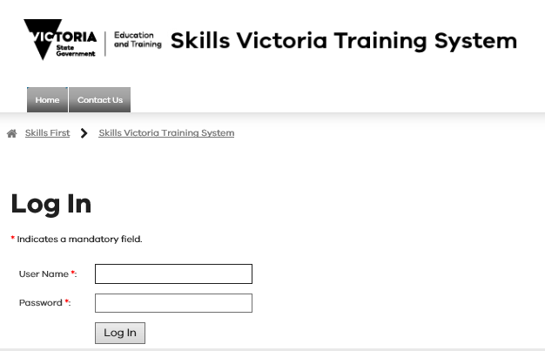
REPORTING – ACFE TRAINING DELIVERY (SVTS)
Note there are separate reporting guidelines for all 2024 ACFE Board funded training delivery, which will be on the Learn Local website.
It is your responsibility to accurately report the delivery of ACFE training programs, in accordance with the agreed Delivery Plan.
Accurate reporting is essential to assist the ACFE Board in understanding and responding to community need for pre-accredited training delivery.

Slide 40
PAYMENTS AND REPORTING SCHEDULE
The SCH subsidy rate will remain at $9.35 in 2024.
The Training Delivery Support Grant will be $5,500.
Fee Concessions – The ACFE Board will reimburse providers for a proportion of the revenue foregone by granting fee concessions to learners in pre-accredited courses, based on reported data in SVTS.
Regional Loading – 20 per cent loading on regional delivery paid in two instalments: in semester one 2024, and in 2025 based on a reconciliation of end-of-year 2024 SVTS reported data.
Koorie loading – a 50 per cent loading on delivery will be paid in semester one 2024 and in early 2025, based on SVTS reported data.
2024 Payment & Reporting Schedule
Milestone no. | Milestone Processing date | Payment percentage (%) | Cumulative payment percentage (%) | Requirement for release of payment
1 | February | 35% | 35% | Contract execution with approved BGS
2 | April | 25% | 60% | 25% enrolments reported by 31 March
3 | May | 0% | 0% | Non-financial progress report by 31 May
4 | August | 20% | 80% | 55% enrolments reported by 31 July
5 | October | 20% | 100% | 75% enrolments reported by 30 September
6 | November | 0% | 0% | Non-financial data check report by 15 November

Slide 41
NEXT STEPS

Slide 42
REGIONAL FORUMS
To help you in developing your Delivery Plans, a number of forums focussing on contracting workshops will be scheduled across regions following these information sessions.
Regional staff will be available at the forums to provide advice and support on how to complete your delivery plans.
Regional Forums will be held in September 2023.
You are encouraged to attend, particularly if you have any questions about the Delivery Plan.
Please contact your Regional Office for further information.

Slide 43
TIMELINES & NEXT STEPS
28 AUGUST 2023
28 AUGUST 2023
31
AUGUST
OR 5 SEPTEMBER
2023
THROUGH SEPTEMBER
2023
BY 15 September 2023
Read and action the Memo, to commence the ACFE 2024 Training Delivery EOI process
Download the 2024 Guidelines for the program you are applying for and the 2024 Delivery Plan Template from the website
Participate in an Information Session and review the information on the website
Attend a regional forum for assistance with contracting or to discuss partnership options with other Learn Local providers in your region.
Complete & submit your Delivery Plan EOI in ONE email and if applicable A-frames, to: training.participation@education.vic.gov.au
BY NOVEMBER 2023
BY 30 NOVEMBER 2023
BY DECEMBER
2023
DECEMBER 2023
FEBRUARY
2024
Regional Office staff will review your Delivery Plan and confirm contracted delivery by LGA and program stream with you
A-frames can be submitted. You are not required to submit A-frames for centrally developed modules
Ensure you have a current BGS and financial statements uploaded in SAMS2 system (if on financial year)
Contracts will be uploaded into SAMS2
First advance payment, where all contract requirements are met

Slide 44
NOTIFICATIONS OF OUTCOMES
Providers will be formally notified via email regarding assessment of their Delivery Plan EOI, and the approved funding outcome by November 2023.
Contracts will be uploaded into SAMS2 in December 2023 for approval.
Check and ensure that your organisation’s contact details and signatories are up to date in SAMS2, to ensure timely contracting.

Slide 45
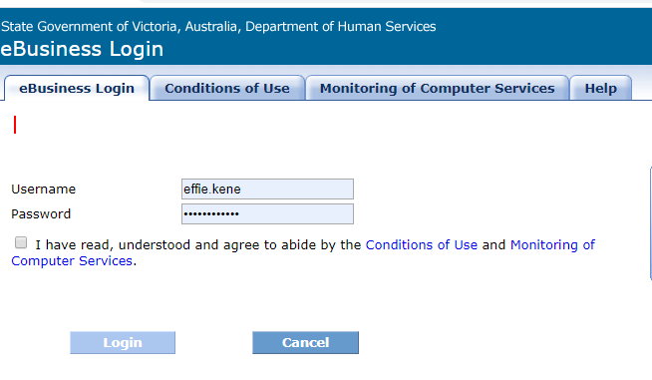
CONTRACTING IN SAMS2
SAMS2 – SERVICE AGREEMENT
Providers are contracted via a Service Agreement in SAMS2.
SERVICE PLAN
Service Plans are listed within the Service Agreement. General Pre-accredited Training Delivery and Additional Digital and Employability Places will be listed as separate Service Plans.
SUBCONTRACTING
As per the ACFE Board procurement policy, Learn Local providers who are contracted to deliver training in a given year must not outsource this training to another organisation

Slide 46
DELIVERY PLAN VARIATIONS AND ADJUSTMENTS
VARIATIONS
ADJUSTMENTS
Approval must be obtained for all variations to contracted Delivery Plans by the Department before making any changes and commencing delivery.
A variation to the Delivery Plan that includes changes to program stream or LGA targets, can only be requested during a formal variation window. It is expected that, as in 2023, there will be an open round for Delivery Plan variations, from April to the end of September 2024.
Please ensure the Chairperson (or approved delegate) of your organisation approves any variation prior to submitting a request.
You can make adjustments to module delivery on the Delivery Plan Worksheet through negotiation with your Regional Manager, where this does not impact on program stream or LGA targets.

Slide 47
CHECK LIST
Important EOI details to check:
Current BGS and financial statements completed and uploaded in SAMS2 by December 2023 if on financial year.
Contact details and signatory up to date in the Delivery Plan and in SAMS2.
Ensure Delivery Plan EOI for all program streams is submitted in ONE email to training.participation@education.vic.gov.au
Following EOI submission, ensure you receive an acknowledgement of your EOI application.
Ensure you have agreed on an approved Delivery Plan by late October, if not please contact your Regional Office.

Slide 48
THANK YOU
We’ll review your questions from the chat and provide:
Frequently Asked Questions document
Copy of presentation slides
These will be located on the Learn Local website under pre-accredited training and programs

